Slide 1
Information System Task
Made by Mohamed Emziane

Slide 2
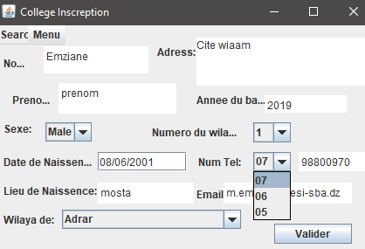
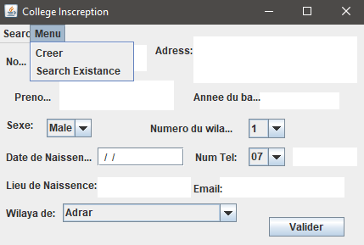
Interface
Welcome to Input Screen:
Create student’s inscription file,
if you already registered then
insert only name and first name
after that choose ‘search Existance’,
If not register and tap ‘valider’ to add
To student’s inscription file,

Slide 3
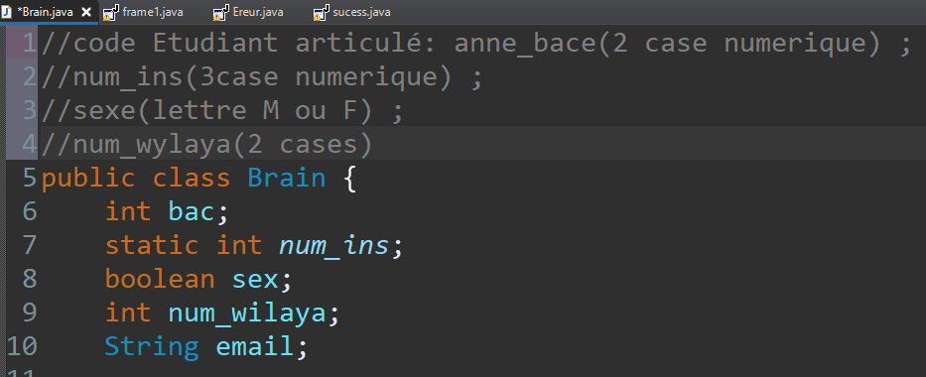
Codification articulée
← This belongs to functionalities not codage

Slide 4
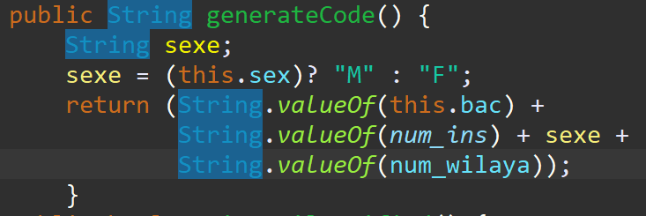
Application functionalities

Slide 5
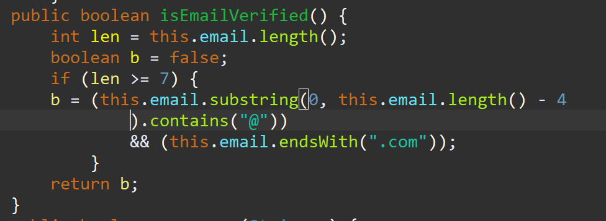
Application functionalities
// basic email contain ‘G@G.com’ so
Length must be at least seven

Slide 6
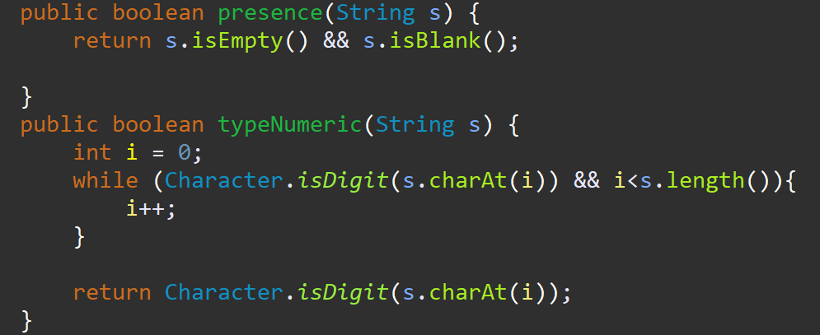
Data Control

Slide 7
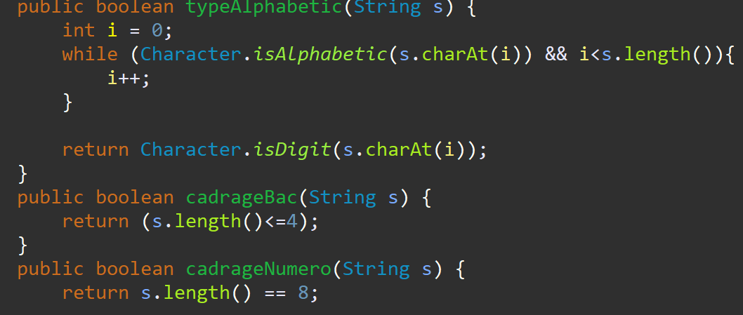
Data Control

Slide 8
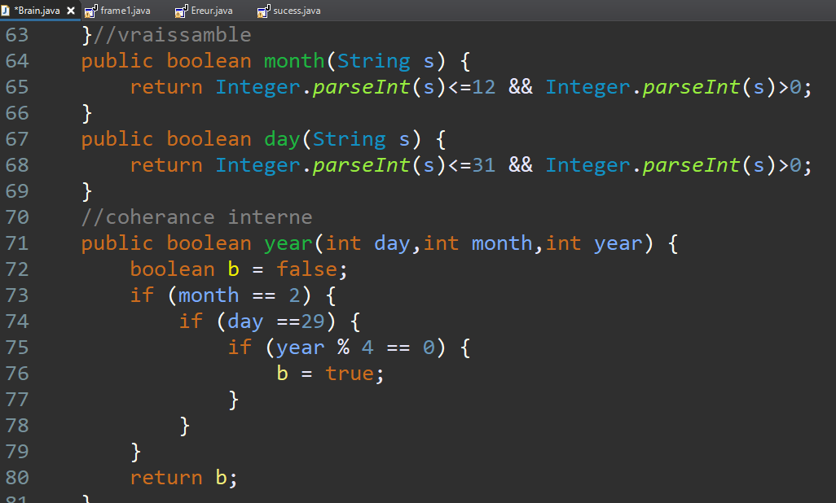
Data Control

Slide 9
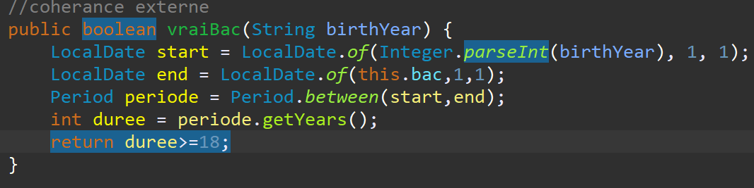
Data Control
//12 yo kid cant have bac in algeria

Slide 10
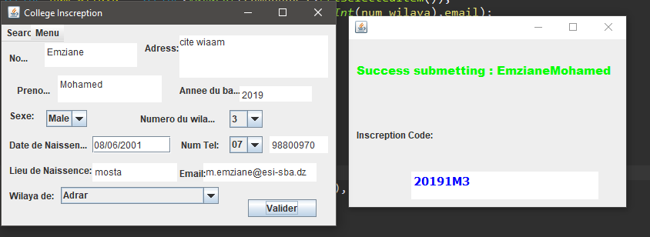
Success (Result windows):

Slide 11
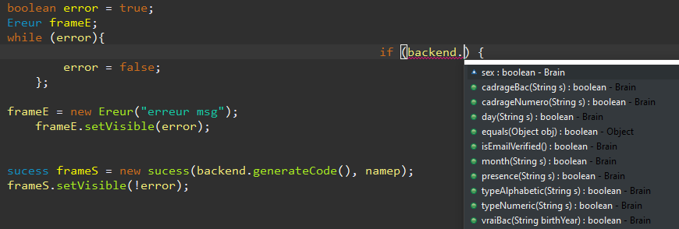
Warning user LOGIC(Error POPUPS)
//backend: objet de type brain qui a tout les control (Boolean methods)
&&&&&&&&&&

Slide 12
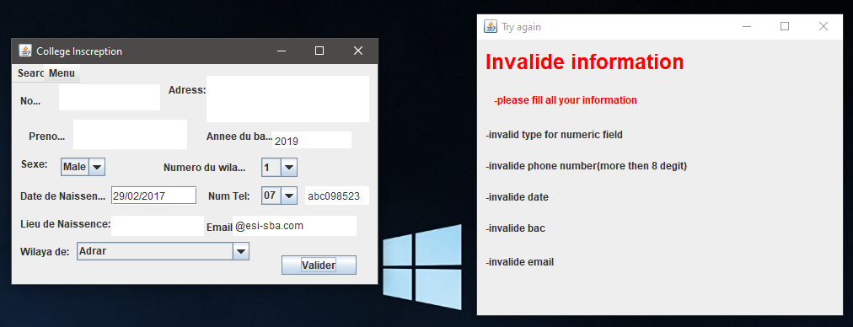
Control live EXAMPLES:

